Slide 2
WELCOME
TO WORLD CONFERENCE 2017
REGISTRATION TRAINING

Slide 3
At Registration we will process the following:
New Attendees
Those that have not registered on line “Walk Ins”
Pre - Registered Attendees - but DID NOT receive their wristband in the mail
The address was invalid, we should have in our “Returned Mail Area”
Registered AFTER the mailing deadline – Wristbands were not mailed
WC Daily Volunteers
Ushers, Security, Admin

Slide 4
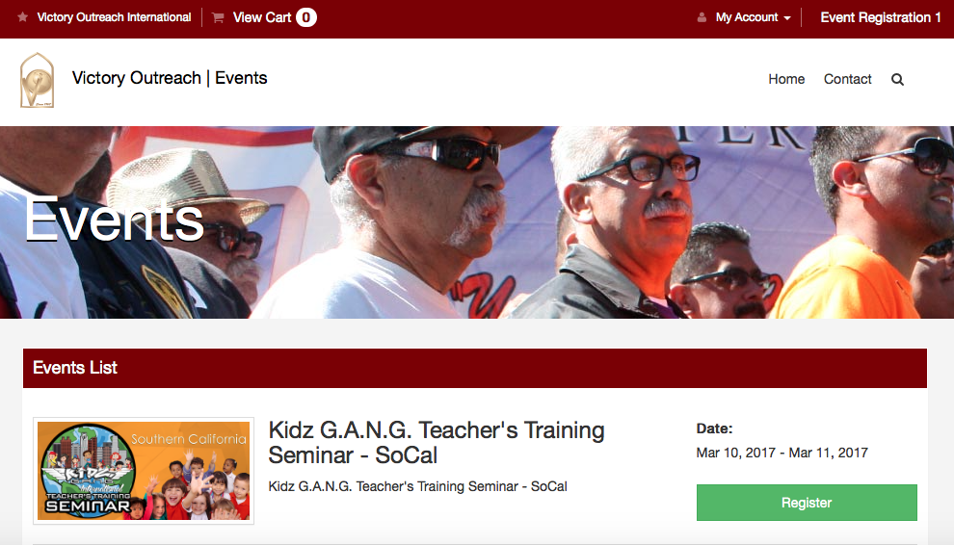
LOG IN PROCESS:
CLICK: MY ACCOUNT THEN ADMIN

Slide 5
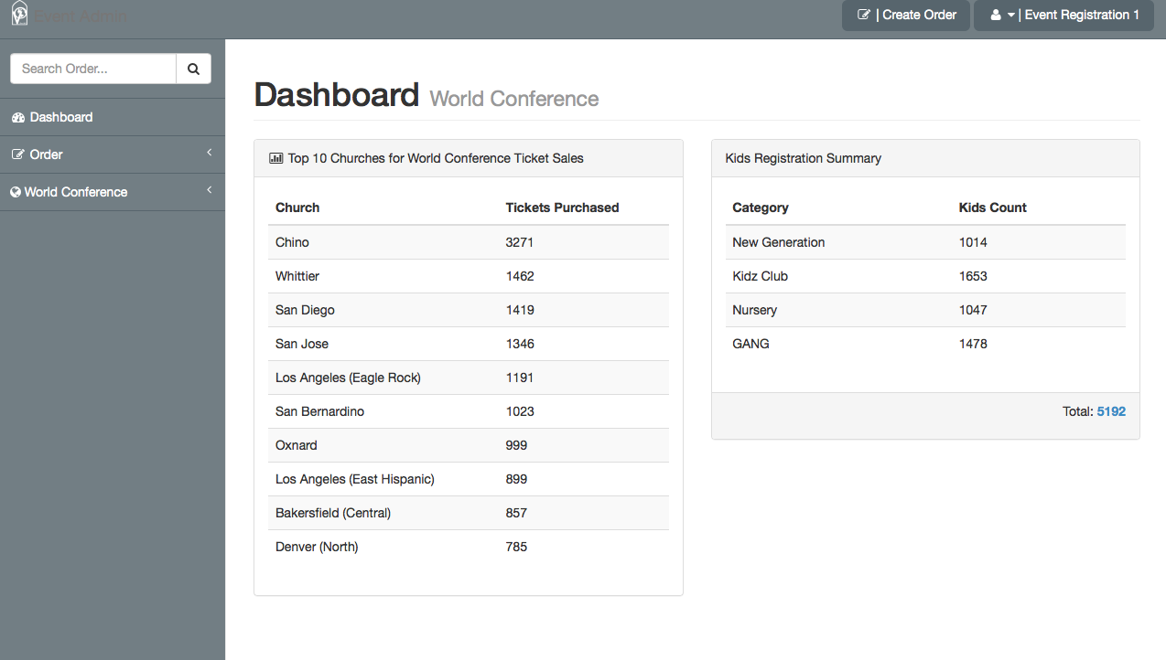
EACH ATTENDEE IS AN “ORDER”

Slide 6
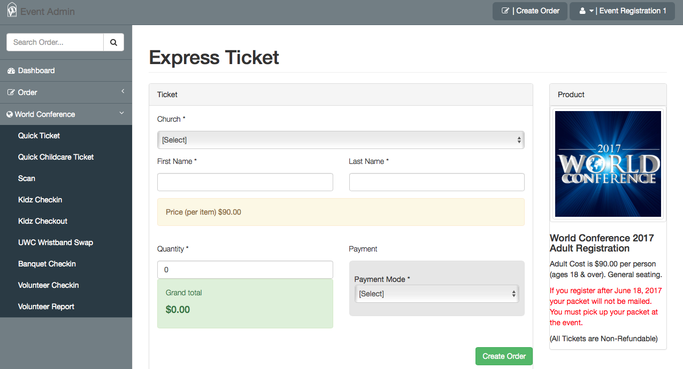
NEW ATTENDEE PROCESS
CLICK - WORLD CONFRENCE
CLICK – QUICK TICKET

Slide 7
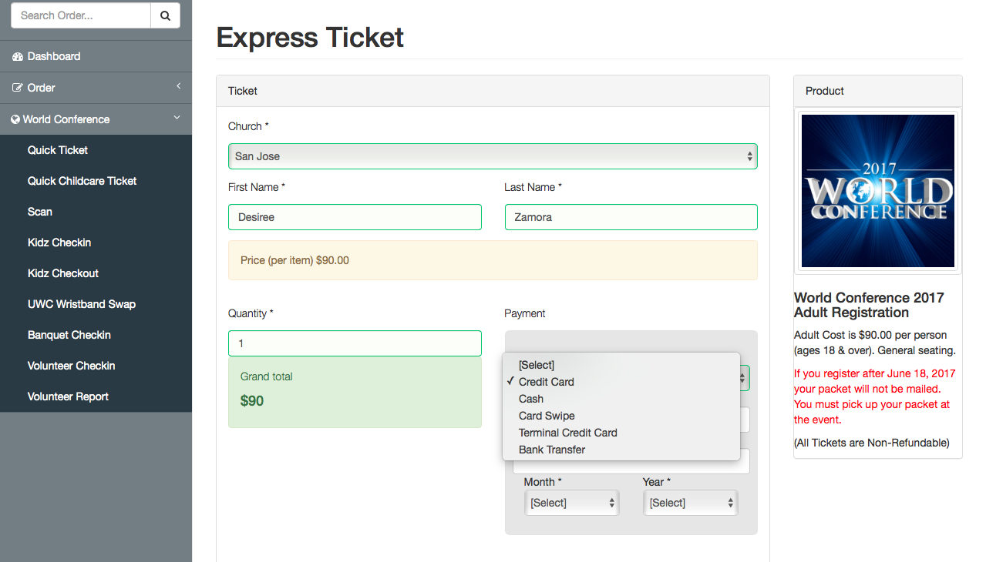
NEW ATTENDEE PROCESS
ENTER ALL INFO
PAYMENT METHOD

Slide 8
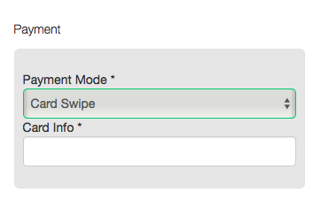
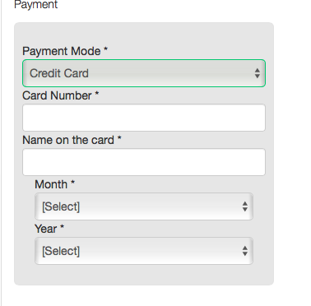
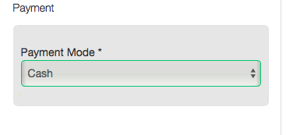
PAYMENT METHODS

Slide 9
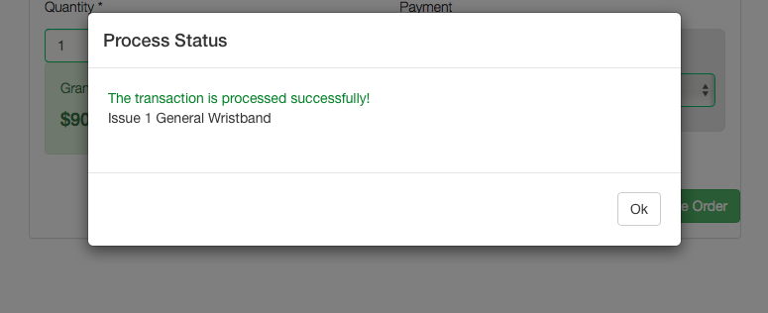
WRISTBAND ISSUANCE …
***WHEN ISSUING WRISTBANDS MAKE SURE IT’S THE COORECT COLOR AND ALWAYS COUNT OUT ***

Slide 10
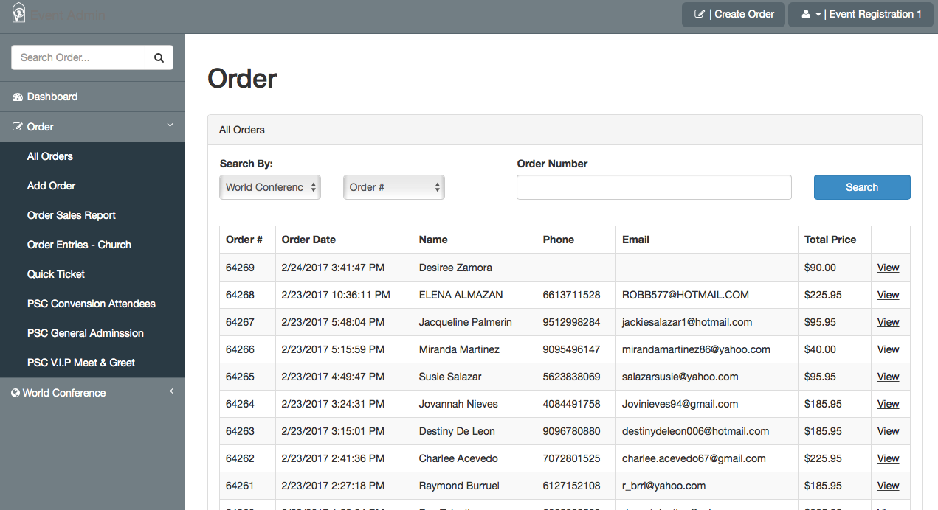
2) PRE - REGISTERED ATTENDEES –
DID NOT receive their wristband in the mail - Search “Order”
CLICK: ORDER ➔ ALL ORDERS ➔ SEARCH BY: WORLD CONFERENCE ➔ CLICK : VIEW

Slide 11
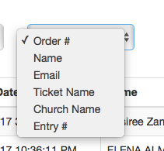
2) PRE - REGISTERED ATTENDEES –
Search by :
- ORDER # (They will have on their phone ot paper form)
- NAME (Person who purchased the tickets)
- EMAIL (Of person who placed order)
- TICKET NAME (Purchaser bought for someone else & put under their name)
CHURCH NAME

Slide 12
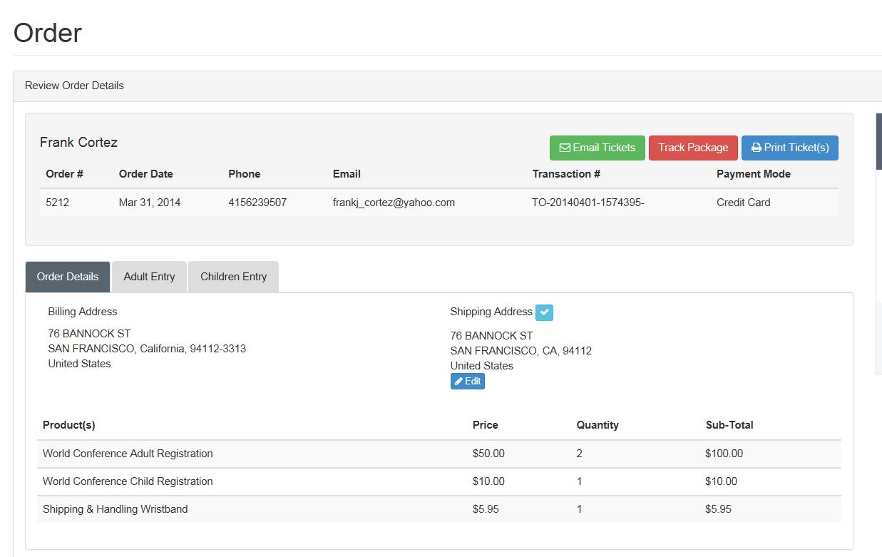
CHECK TO SEE IF THE WRSITBANDS WERE MAILED

Slide 13
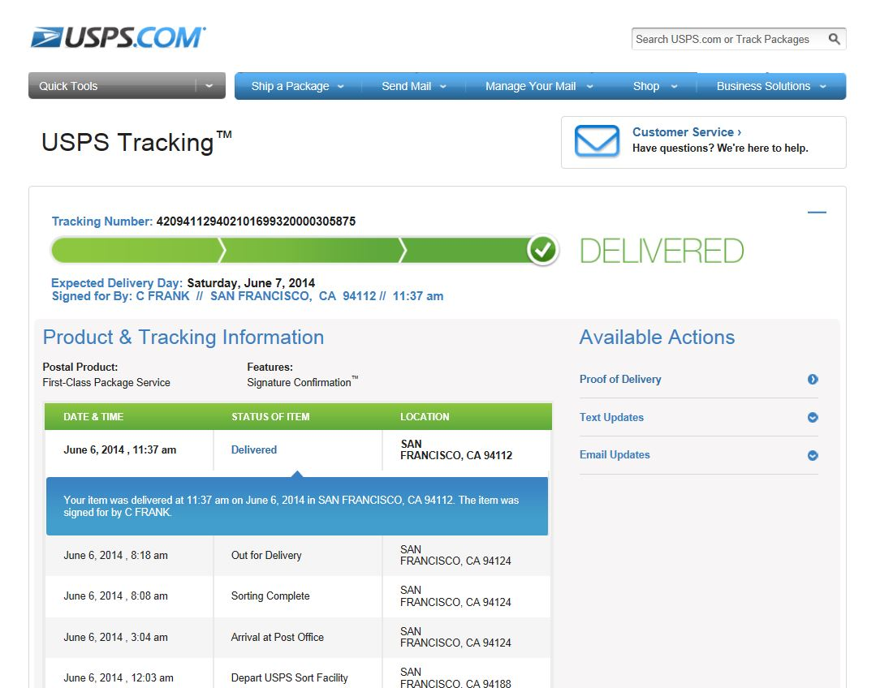
CLICK TRACK PACKAGE ➔ USPS TRACKING

Slide 14
2) PRE - REGISTERED ATTENDEES –
IF PACKAGE WAS DELIVERED –
THIS WRISTBAND WERE RECEIVED. DO NOT ISSUE ADDITIONAL WRISTBANDS.
2) CONFIRM THE NAME SIGNED UPON DELIVERY.
3) SEND TO TROUBLESHOOTING / HELP DESK

Slide 15
2) PRE - REGISTERED ATTENDEES –
IF PACAKGE WAS NOT DELIVERED –
CHECK THE “RETURNED MAIL AREA”
IF NOT IN THERE
- THE MAIL COULD STILL BE RETURNING TO VOI
- THEY REGISTERED AFTER THE MAILING CLOSED
ISSUE WRSITBANDS AND FOLLOW WRISTBAND ISSUANCE

